Slide 1
IIT MANDI · HIMSHIKHAR PROJECT PROGRAM · MACHINE LEARNING
Road Accident Severity &
Safety Hotspot Analyzer
Predicting accident severity with machine learning, uncovering high-risk patterns, and turning 12,316 real accident records into actionable road-safety recommendations.
12,316
32
3
84.58%
RECORDS
FEATURES
ML MODELS
BEST ACCURACY
Team Komal Kumari · Pallavi · Shruti Saini
Dataset: Kaggle — Road Accidents Severity (RTA) | github.com/KomalKumari27
Road Accident Severity & Safety Hotspot Analyzer
01

Slide 2
OVERVIEW
Agenda
How this presentation is structured
01
Problem & Objectives
02
Dataset at a Glance
Why accident severity prediction matters
12,316 records · 32 features · 3 severity classes
03
Tech Stack & Workflow
04
Exploratory Data Analysis
Tools, project structure and the 8-step pipeline
When, who, where and why accidents happen
05
Model Training & Evaluation
06
Feature Importance
Logistic Regression vs Decision Tree vs Random Forest
What actually drives severity
07
Hotspots & Recommendations
08
Insights, Limitations & Future Scope
High-risk patterns → concrete safety actions
What we learned and where this goes next
Road Accident Severity & Safety Hotspot Analyzer
Overview | 02

Slide 3
THE CHALLENGE
Problem Statement & Objectives
🎯
Predict severity
THE PROBLEM
Classify each accident as Slight, Serious or Fatal from conditions known at the scene.
Road accidents are among the leading causes of injuries and fatalities worldwide. Authorities react after crashes happen — they lack tools to anticipate which conditions turn an ordinary trip into a severe accident.
🔍
Identify high-risk patterns
Mine the data for combinations of weather, light, road and driver factors that raise severity.
Understanding the factors behind accident severity lets governments and transport authorities act preventively — before lives are lost.
📊
Explain the drivers
Rank the most influential accident factors using model feature importance.
💡
Recommend actions
Translate findings into concrete safety recommendations for decision-makers.
Road Accident Severity & Safety Hotspot Analyzer
Overview | 03

Slide 4
WHY IT MATTERS
Real-World Impact & Stakeholders
Data-driven road-safety planning for the people who need it
🚦
🛣️
🏛️
🚑
🚗
Traffic Police
Road Safety Authorities
Government Agencies
Emergency Response
Transport Departments
Prioritise patrols and enforcement where severe accidents are most likely.
Target lighting, signage and surface maintenance to high-risk segments.
Ground policy and budget decisions in evidence, not anecdotes.
Anticipate severe-accident conditions to position responders faster.
Design awareness campaigns for the riskiest driver groups and behaviours.
The goal: shift road safety from reactive investigation to proactive prevention using patterns hidden in historical accident data.
Road Accident Severity & Safety Hotspot Analyzer
Overview | 04

Slide 5
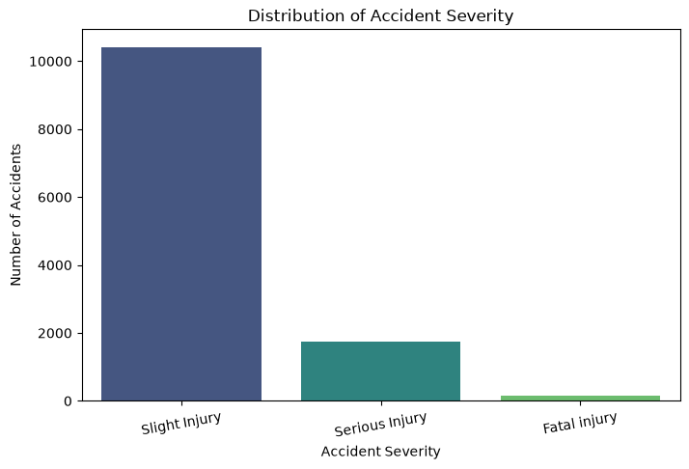
THE DATA
Dataset at a Glance
Road Traffic Accident (RTA) dataset — Kaggle
12,316
CLASS BALANCE
ACCIDENT RECORDS
Slight Injury
≈ 84.5%
32
Serious Injury
≈ 14.1%
RAW FEATURES
Fatal Injury
3
≈ 1.3%
SEVERITY CLASSES
Heavily imbalanced — a key challenge for modelling and evaluation.
80 / 20
Target variable — Distribution of Accident Severity
SPLIT — TRAIN 9,852 · TEST 2,464
Features cover driver (age band, experience), vehicle, environment (weather, light, road surface) and crash context (cause, vehicles involved, time, day).
Road Accident Severity & Safety Hotspot Analyzer
Data | 05

Slide 6
FOUNDATIONS
Tech Stack & Project Structure
TECHNOLOGIES USED
REPOSITORY LAYOUT
Python
Pandas
NumPy
Scikit-learn
road_accident_severity_analyzer/
Matplotlib
Seaborn
Jupyter Notebook
├─ data/ RTA Dataset.csv · X_train · X_test
├─ notebook/
Git & GitHub
│ ├─ 01_eda.ipynb exploratory analysis
WHAT EACH TOOL DOES
│ ├─ 02_Model_Training.ipynb 3 classifiers + metrics
• Pandas / NumPy — cleaning, encoding, feature engineering
│ └─ 03_Hotspot_Analysis.ipynb patterns & actions
├─ output/
• Seaborn / Matplotlib — 9+ EDA visualisations & severity cross-tabs
│ ├─ safety_recommendations.csv
• Scikit-learn — model training, metrics, feature importance
│ └─ screenshots/ 13 result charts
├─ docs/ project report (PDF)
• Jupyter — 3 staged notebooks: EDA → Training → Hotspots
├─ requirements.txt
└─ README.md
Road Accident Severity & Safety Hotspot Analyzer
Data | 06

Slide 7
METHODOLOGY
End-to-End Project Workflow
Eight stages from raw CSV to safety recommendations
1
Understand Problem
2
Acquire Data
3
Clean Data
4
Explore (EDA)
Frame severity prediction as multi-class classification
→
Kaggle RTA dataset — 12,316 × 32
→
Handle missing values & inconsistent labels
→
9 analyses across driver, environment & time
5
Engineer Features
6
Train Models
7
Evaluate
8
Recommend
Encode categoricals → 30 model features
→
Logistic Regression · Decision Tree · Random Forest
→
Accuracy, precision, recall, F1, confusion matrix
→
Hotspot analysis → safety actions
Each stage lives in its own notebook, so the analysis is reproducible step by step.
Road Accident Severity & Safety Hotspot Analyzer
Method | 07

Slide 8
01
— Severity & time patterns
— Driver age & experience
— Weather, light & road surface
— Top causes of accidents
Exploratory Data Analysis
What 12,316 accidents reveal about when, who and why
Road Accident Severity & Safety Hotspot Analyzer
08

Slide 9
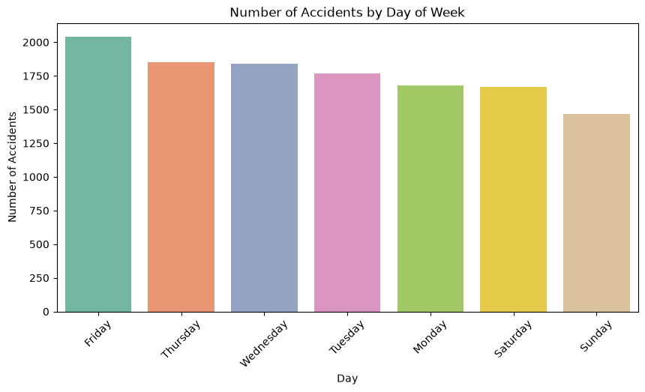
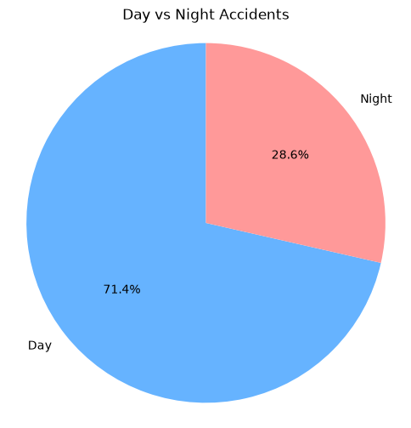
EDA · TIME PATTERNS
When Do Accidents Happen?
STANDOUTS
Friday
peak day (~2,040)
Sunday
quietest day
71.4%
occur in daylight
Accidents by day of week
Day vs night share of accidents
▪ Friday leads: end-of-week commuting and higher traffic volume drive the weekly peak; weekdays consistently beat weekends.
▪ Daylight dominates counts, but night driving carries higher severity risk per trip — reduced visibility and fatigue — which motivates the lighting analysis later.
Road Accident Severity & Safety Hotspot Analyzer
EDA | 09

Slide 10
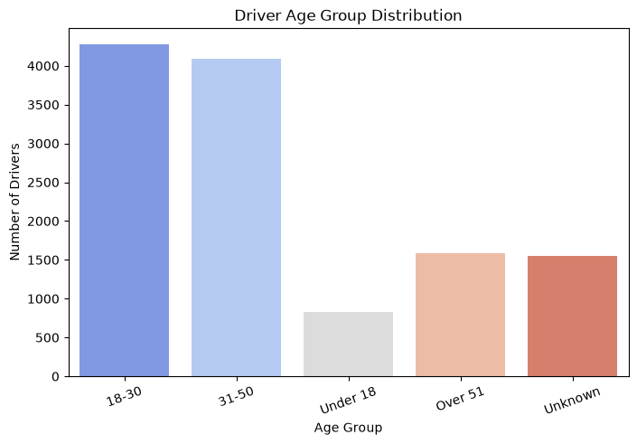
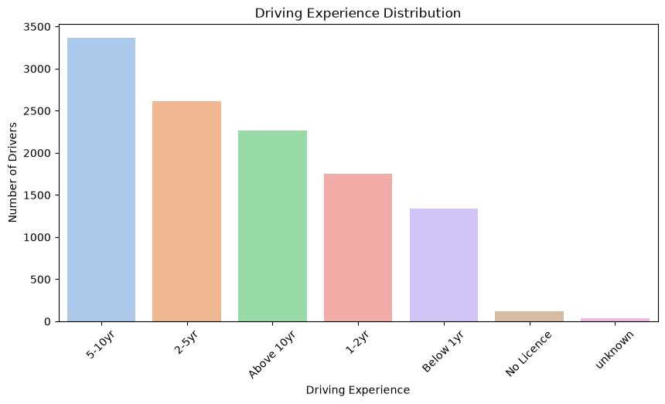
EDA · DRIVER PROFILE
Who Is Involved?
Driver age group distribution
Driving experience distribution
▪ Ages 18–50 dominate (two largest bands ~4,200 each) — the most active driving population is also the most exposed.
▪ Experience doesn't immunise: drivers with 5–10 years of experience top the chart (~3,350), showing over-confidence matters as much as inexperience.
Road Accident Severity & Safety Hotspot Analyzer
EDA | 10

Slide 11
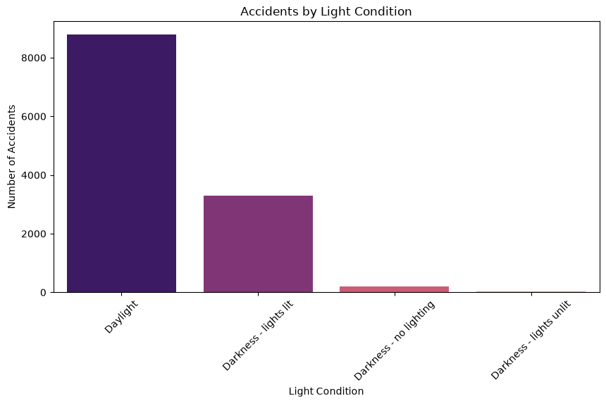
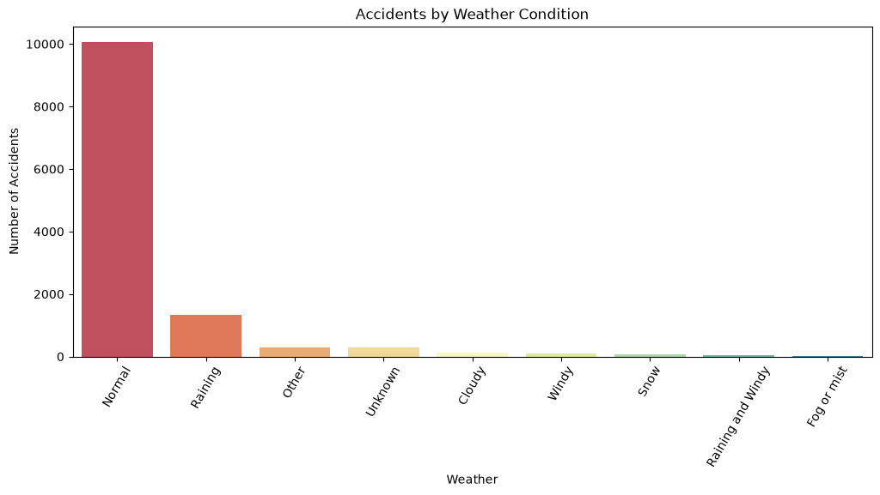
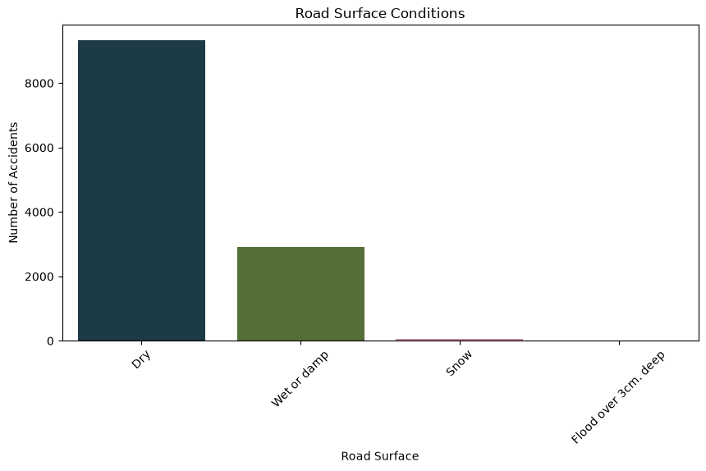
EDA · ENVIRONMENT
Road, Weather & Light Conditions
Accidents by weather
Accidents by light condition
Road surface conditions
▪ Most accidents happen in 'normal' conditions (clear weather, dry roads, daylight) — simply because that's when most driving happens.
▪ Rain and wet/damp surfaces are the leading adverse conditions and show a higher share of serious outcomes — skidding, longer braking distances.
▪ Darkness with lights lit still accounts for ~3,300 accidents — poor lighting is a lever authorities directly control.
Road Accident Severity & Safety Hotspot Analyzer
EDA | 11

Slide 12
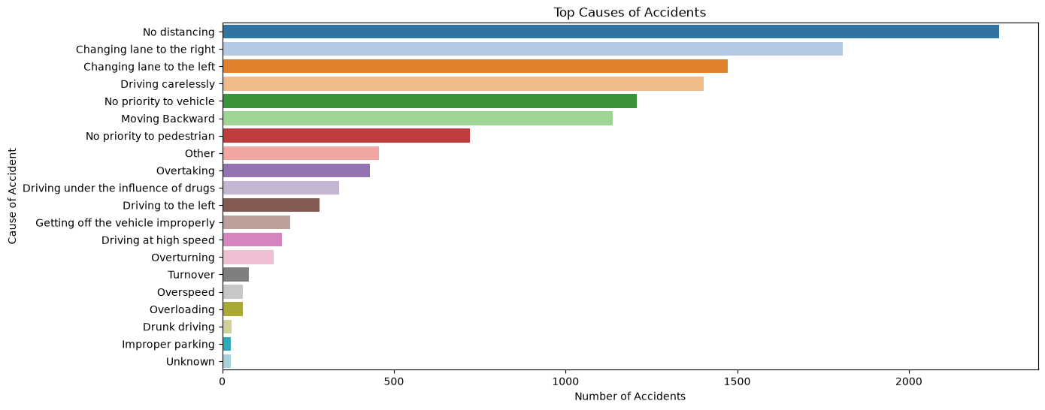
EDA · ROOT CAUSES
Why Do Accidents Happen?
Top causes of accidents — driver behaviour dominates
TOP 5 CAUSES
1
No distancing
~2,260
2
Lane change (right)
~1,810
3
Lane change (left)
~1,470
4
Careless driving
~1,400
5
No priority to vehicle
~1,210
Nearly all top causes are behavioural → preventable.
Cause of accident, ranked by frequency
Tailgating and unsafe lane changes alone account for thousands of accidents — awareness campaigns and enforcement can attack these directly.
Road Accident Severity & Safety Hotspot Analyzer
EDA | 12

Slide 13
02
— Feature engineering & split
— Model comparison
— Accuracy · Precision · Recall · F1
— Confusion matrix & feature importance
Modelling & Evaluation
Three classifiers, one winner — and an honest look at its errors
Road Accident Severity & Safety Hotspot Analyzer
13

Slide 14
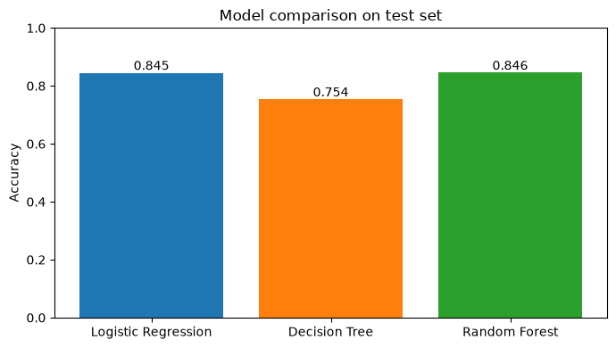
MODELLING
Training & Model Comparison
9,852 training rows · 30 engineered features · evaluated on 2,464 held-out rows
Logistic Regression
84.54%
Strong linear baseline — nearly matches the winner
Decision Tree
75.37%
Overfits the training data; weakest generalisation
Random Forest
84.58%
Best test accuracy + robustness + feature importance
Test-set accuracy of the three candidate models
✓ SELECTED MODEL
Random Forest was selected: it edges out Logistic Regression on accuracy while providing ensemble robustness and interpretable feature importances.
Road Accident Severity & Safety Hotspot Analyzer
Model | 14

Slide 15
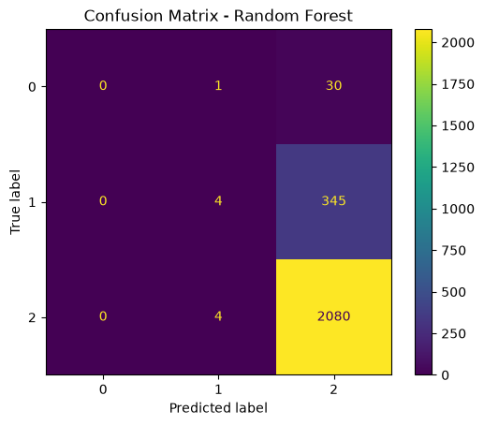
EVALUATION
How Good Is the Model — Really?
Random Forest on the 2,464-row test set (weighted metrics)
84.58%
HONEST READING
ACCURACY
▪ Slight injuries: 2,080 / 2,088 correctly caught — excellent.
▪ Minority classes suffer: most Serious and Fatal cases are pulled toward the majority class.
▪ Root cause: class imbalance (≈85% slight) — accuracy alone overstates performance.
▪ Next step: SMOTE / class weights to lift minority recall.
0.7795
PRECISION (WEIGHTED)
0.8458
RECALL (WEIGHTED)
0.7783
F1 SCORE (WEIGHTED)
Confusion matrix (0=Fatal · 1=Serious · 2=Slight)
Road Accident Severity & Safety Hotspot Analyzer
Model | 15

Slide 16
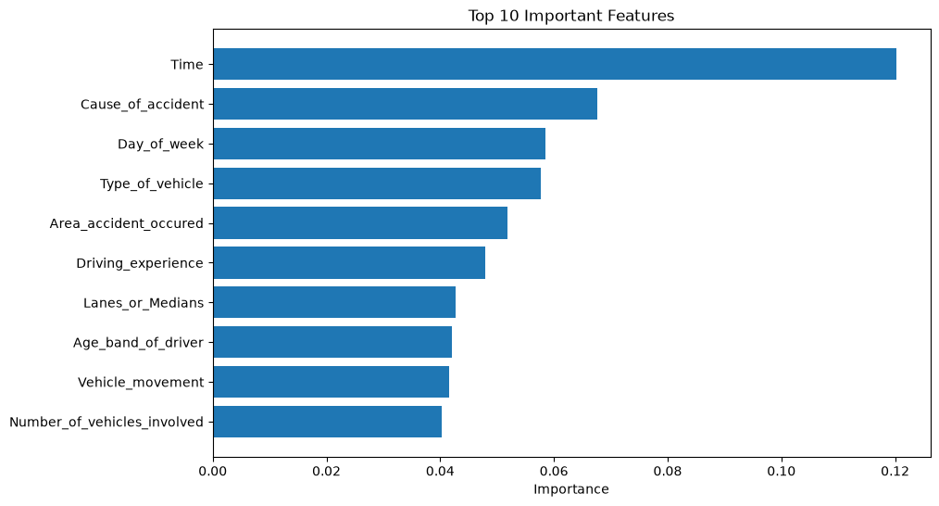
EXPLAINABILITY
What Drives Accident Severity?
Top 10 features by Random Forest importance
⏰
Time of day
By far the strongest signal (0.120) — severity risk shifts across the day.
⚠️
Cause of accident
Behavioural causes (0.068) directly shape outcomes.
📅
Day of week & vehicle type
Traffic rhythm and vehicle class both matter (~0.058 each).
🧑‍✈️
Driver factors
Experience and age band appear in the top 10 — confirming the EDA.
Random Forest feature importances
Environment sets the stage, but time and human behaviour dominate — exactly where policy interventions are cheapest.
Road Accident Severity & Safety Hotspot Analyzer
Model | 16

Slide 17
03
— Severity vs light conditions
— High-risk pattern summary
— Concrete safety actions
— Limitations & future scope
Hotspots & Recommendations
From patterns in the data to actions on the road
Road Accident Severity & Safety Hotspot Analyzer
17

Slide 18
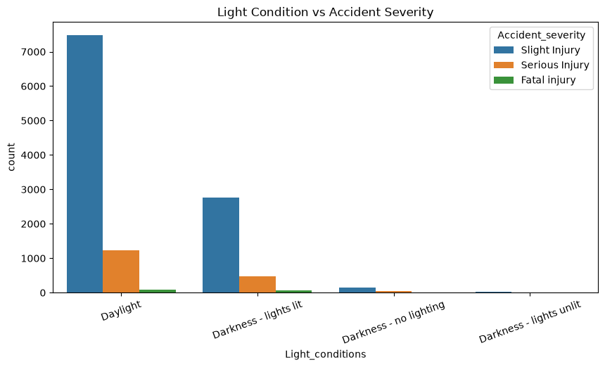
HOTSPOT ANALYSIS
Where Severity Concentrates
Cross-tabulating conditions against severity reveals high-risk scenarios
Poor lighting
Darkness — even with lights lit — carries a higher share of serious & fatal outcomes.
Adverse weather
Rain shows a disproportionately serious accident profile despite fewer total crashes.
Wet / damp surfaces
Different accident pattern vs dry roads: skidding & reduced grip raise severity.
Risky driver groups
Light condition vs accident severity
Young drivers and behavioural causes (tailgating, lane-changes) recur across severe cases.
A 'hotspot' here is a condition pattern, not a GPS location — the dataset has no coordinates, so the analysis targets when and how, not where on the map.
Road Accident Severity & Safety Hotspot Analyzer
Insights | 18

Slide 19
DELIVERABLE
Safety Recommendations
Generated by the analysis and exported to safety_recommendations.csv
RISK FACTOR
RECOMMENDED ACTION
PRIMARY OWNER
🌧️
Rainy weather
Reduce speed limits during rain
Traffic authorities
💡
Poor lighting
Install additional street lights
Road safety dept.
👀
Driver inattention
Increase awareness campaigns
Government / media
🛣️
Wet roads
Improve road maintenance
Public works
🧑‍🎓
Young drivers
Provide defensive driving training
Licensing bodies
Each recommendation maps a data-confirmed risk factor to a low-cost, high-leverage intervention that authorities can act on immediately.
Road Accident Severity & Safety Hotspot Analyzer
Insights | 19

Slide 20
REFLECTION
Key Insights & Honest Limitations
✅ KEY INSIGHTS
⚠️ LIMITATIONS
▪ 85% of accidents cause slight injuries — but the rare severe ones are what matter most.
▪ Human behaviour is the biggest lever: tailgating and lane changes top the cause list.
▪ Time of day is the #1 predictive feature for severity.
▪ Random Forest wins at 84.58% test accuracy over LR (84.54%) and DT (75.37%).
▪ Mid-experience drivers (5–10 yrs) crash the most — experience ≠ safety.
▪ Historical data only — no real-time traffic or weather feeds.
▪ No GPS coordinates, so hotspots are condition patterns, not map locations.
▪ Class imbalance depresses minority-class (Fatal/Serious) precision and F1.
▪ Data quality dependent: 'Unknown' categories add noise.
▪ Decision support, not replacement for expert judgement.
Road Accident Severity & Safety Hotspot Analyzer
Insights | 20

Slide 21
ROADMAP
Future Scope
Where this project goes next
🖥️
NEXT UP
⚖️
MODELLING
🗺️
DATA
Streamlit dashboard
Handle imbalance
GPS hotspot mapping
Enter accident details → predict severity → view recommendations, live.
SMOTE / class weights + XGBoost & LightGBM to lift Fatal-class recall.
Geo-coded data to visualise true map-based accident hotspots.
🌦️
DATA
🧠
MODELLING
☁️
DEPLOYMENT
Live API integration
Deep learning
Cloud + mobile
Real-time weather and traffic feeds for on-the-fly risk scoring.
Neural approaches once richer data is available.
Deployed service and mobile app for field use by authorities.
Road Accident Severity & Safety Hotspot Analyzer
Closing | 21

Slide 22
Thank You
Every severe accident predicted is a chance to prevent one. This project shows how open data and simple, well-evaluated machine learning can guide real road-safety decisions.
TEAM
PROGRAM
RESOURCES
Komal Kumari
IIT Mandi
Kaggle RTA Dataset
Pallavi
Himshikhar Project Program
github.com/KomalKumari27
Shruti Saini
scikit-learn · pandas · seaborn
Road Accident Severity & Safety Hotspot Analyzer
22

